Slide 1
Do Now:
What are healthy foods?
List three carbohydrate foods.
List three protein foods.
Why is it important to eat healthy foods?

Slide 2
Nutrition

Slide 3
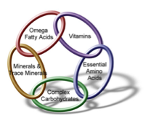
Classes of Nutrients
Carbohydrates
Fats
Proteins
Vitamins
Minerals
Water
Notes:
Carbs: preferred energy source for brain and important for cells. Include sugars, starches, and fiber
Fat: lipids. Energy giving nutrient. 2nd form of energy storage
Protein: class of amino acids. Needed to build, repair, and regulate body
Vitamins: for health and growth
Minerals: needed for bone formation and enzyme activity

Slide 4
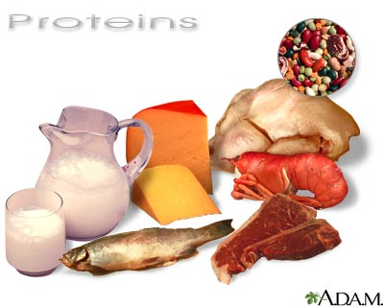
Protein
Needed to build and repair body structures
Regulate processes of the body
Meat, fish, poultry, and dairy are highest in protein
Recommended 35-105 grams/day (10-30% of daily intake)

Slide 5
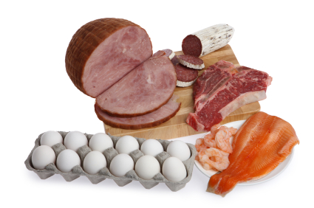
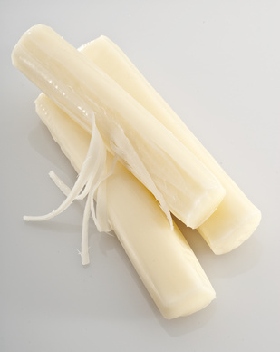
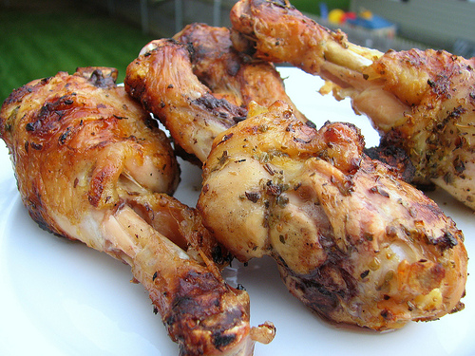
Protein Sources

Slide 6
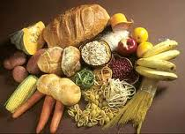
Carbohydrates
Preferred energy source
Recommended 158-228 grams/day (45-65% of daily intake)
Includes starches, complex carbs, and added sugar

Slide 7
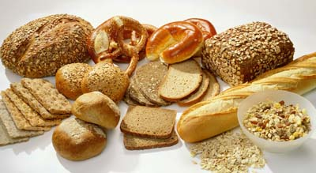
Carbohydrate Sources

Slide 8
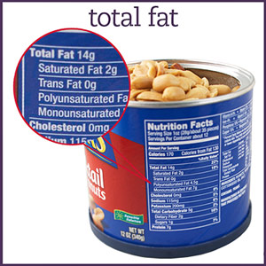
Fat
Calories from fat
Limit amount of fat in diet
Recommended 31-46 grams/day (20-30% of daily intake)
Total fat: number of fat grams per serving
Unsaturated fat
Saturated fat: Unhealthy fat
Trans fat
Notes:
Saturated fat: fat that is solid at room temperature
Comes from animal food products (i.e. beef, lamb, pork, lard, butter, whole milk)
Some from plants i.e. coconut oil, palm oil, cocoa butter
Too much → high cholesterol → risk for cardiovascular disease
Unsaturated fats: from plants and remain liquid at room temperature
Trans fat: when liquid fats are made into solid fats (done to increase shelf life) Unhealthy fat

Slide 9
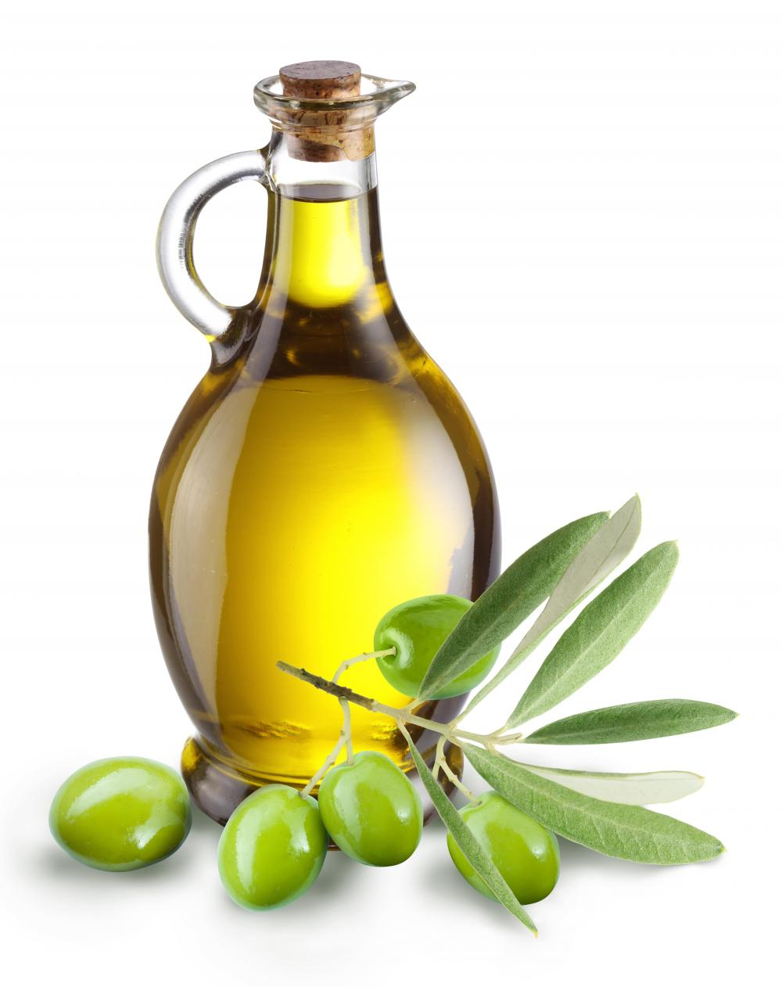
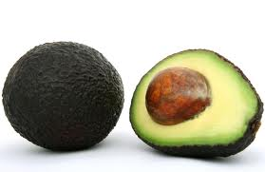
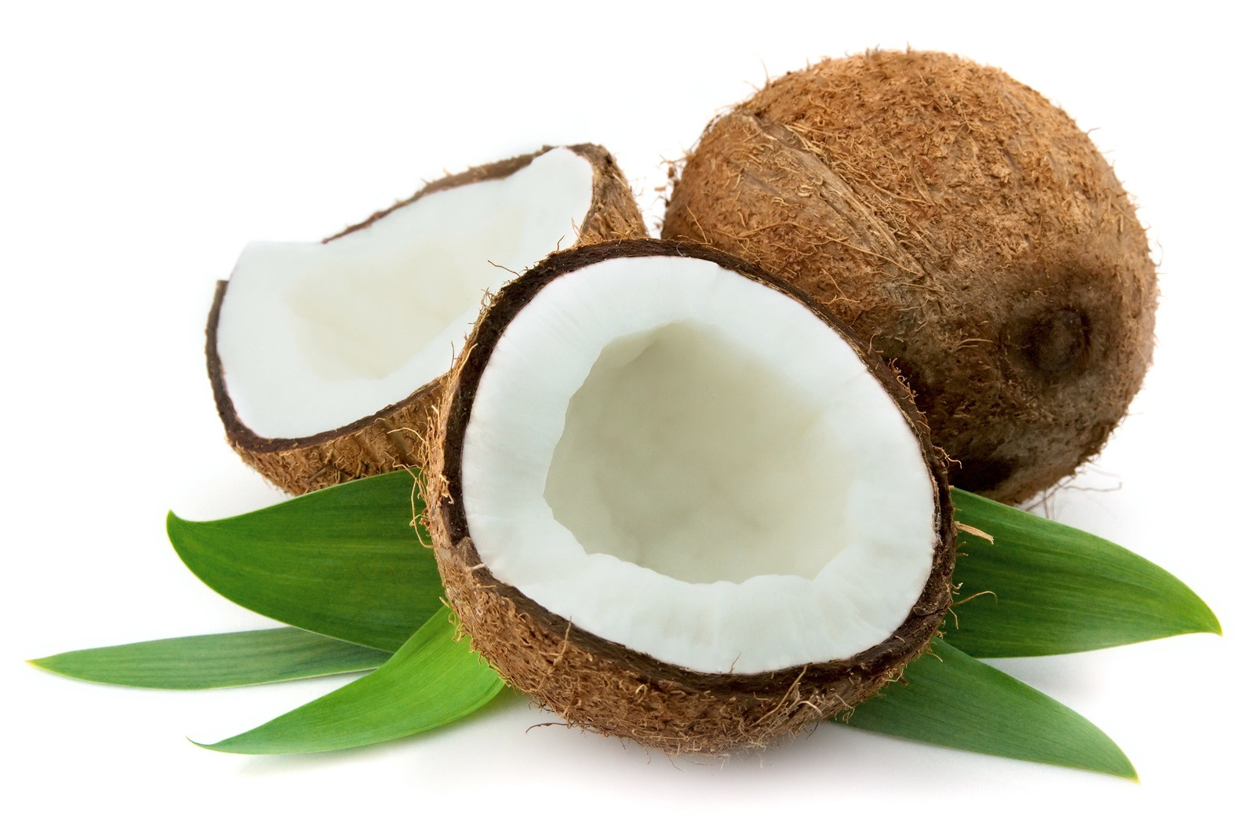
Fat Sources

Slide 10
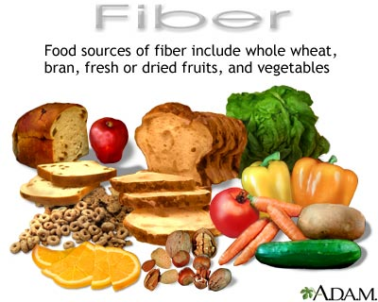
Fiber
Indigestible carbohydrate
Aids in elimination
Helps lower cholesterol
Recommended: minimum 15 grams per day

Slide 11
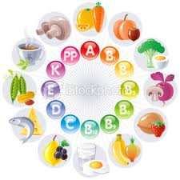
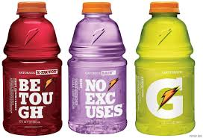
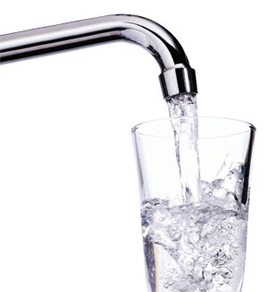
Vitamins
Water
Substances that are required for many different bodily functions
Don’t supply any energy
13 essential vitamins:
body cannot make them
need to eat them
A, B1, B2, B3, B5, B6, B12, biotin, folate, C, D, E, K
Body is mostly water
Need water to stay healthy
Minimum amount of water per day is 1.5 L or 7 cups
Need more if exercise, sick, or it’s hot outside
Thirst is a late sign of not being hydrated

Slide 12
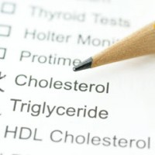
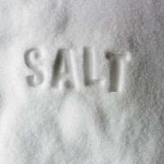
Cholesterol
Sodium
Amount (mg) of cholesterol
What percent of recommended daily value
Type of fat
Amount of salt
Should be < 2400 mg/day
Teaspoon of table salt

Slide 13
Balanced Nutrition

Slide 14
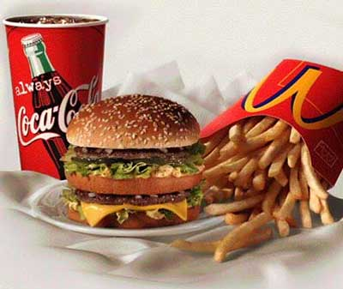
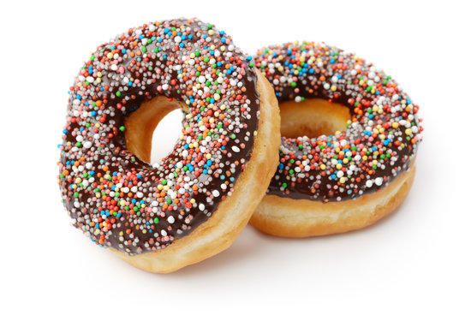
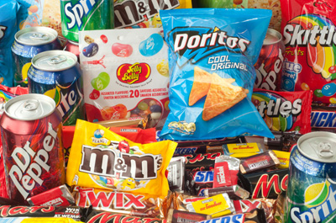
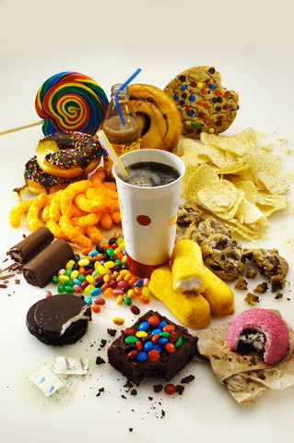
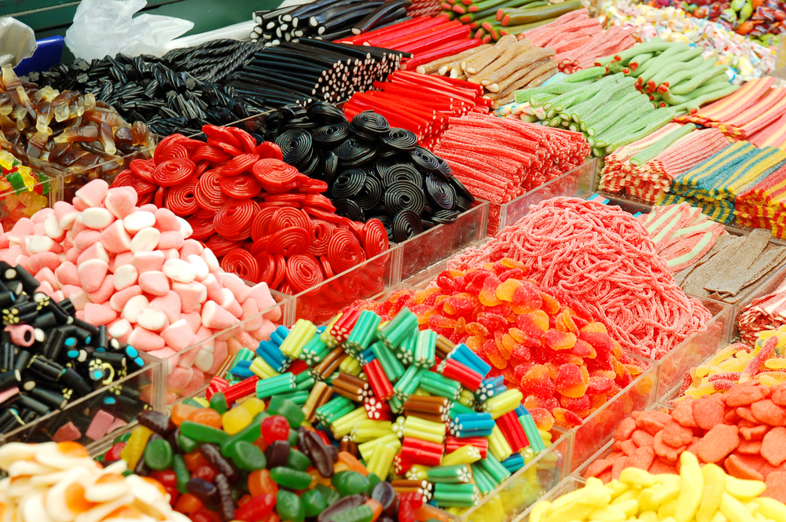
Non-nutrient Foods

