Slide 1
Nursing

Slide 2
Levels of Nursing
LPN (Licensed Practical Nurse)
High School Degree
One Year of Training (no degree)
Licensing Exam
Work under RN
No chance for Promotion
2012 Salary: $41,540 (national average)
RN (Registered Nurse)
Associates, Bachelors, or Masters degree in science
Licensing Exam
No Criminal Background
Chance for Promotion
2012 Salary: $67,930 (national average)

Slide 3
Nurses: What Is There Role?
Treat Patients
Educated Patients and Families
Provide Advice
Provide Emotional Support

Slide 4
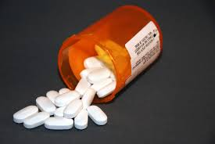
Nurses: Job Tasks
Record Medical Histories
Assess Symptoms
Perform Tests
Analyze Results
Administer Medications
Monitor Vitals (heart rate, blood pressure, temperature)

Slide 5
Nursing Specialties
Emergency & Trauma
Critical Care
Cardiac
Case Management
Geriatric
Medical-Surgical
Mental Health
Midwifery
Neonatal
Obstetric
Oncology
Pediatric
Wound Care

Slide 6
Statistics: Where Do They Work?

Slide 7
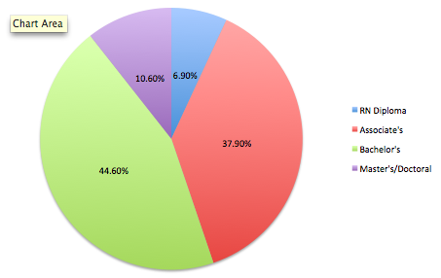
Statistics: Education Level
HRSA:2013

Slide 8
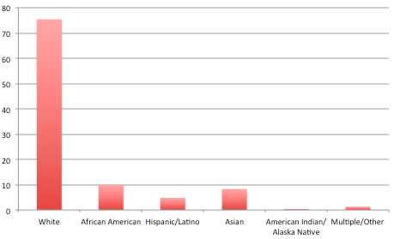
Statistics: Multicultural Career
HRSA:2013

Slide 9
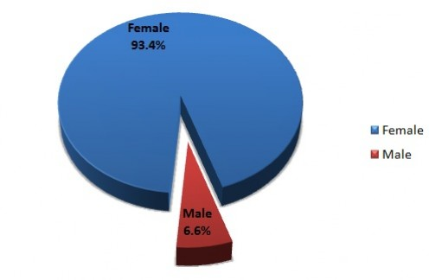
Statistics: Nursing By Gender

Slide 10
Should I Become a Nurse?
I like to take care of people
I want to make people feel better
I know what it’s like to have a certain condition (I can relate to patients)
I have an interest in healthcare or medicine
I have an interest in science

