Slide 1
Do Now:
What is high blood pressure?
List three way to reduce high blood pressure.
Why is having high blood pressure a concern?

Slide 2
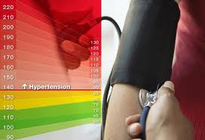
Hypertension

Slide 3
What is hypertension
The physical force exerted by the blood as it pushes against the walls of the arteries.
An elevated blood pressure means that the heart must work harder to pump blood.
High blood pressure can also damage the walls of the arteries.
With time, hypertension increases the risk of heart disease, kidney disease, and stroke.

Slide 4
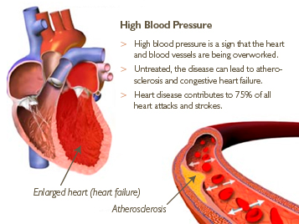

Slide 5
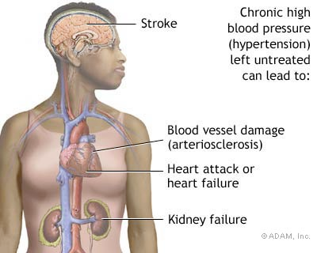
Symptoms
- “silent killer”
Major risk for strokes and heart attacks
If not treated, lungs, brains, kidneys, heart and circulation may be damaged
Cause is unknown

Slide 6
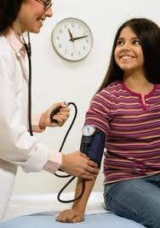
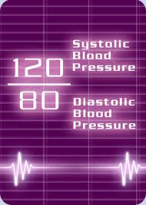
Systolic and Diastolic
Systolic = pressure when the heart beats
Diastolic = pressure between heart beats (while heart is refilling with blood)
Normal: 120/80

Slide 7
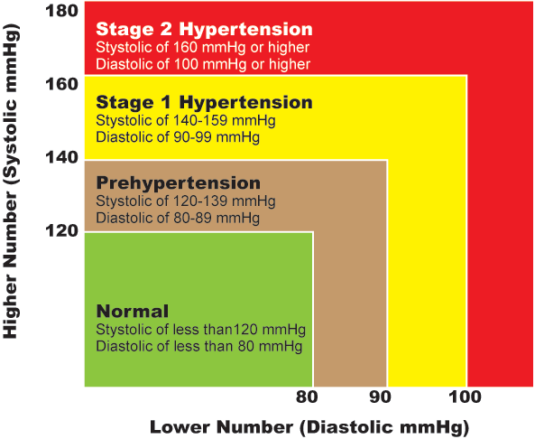

Slide 8
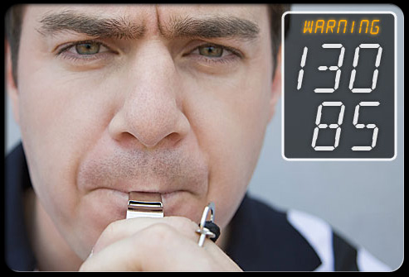
Pre-hypertension
Blood pressure is just above normal
Life style changes can help in this stage

Slide 9
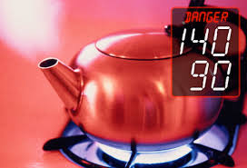
Hypertension Danger Zone
* BP is 140/90 or higher
Still may not have symptoms
180/110 or higher
Hypertensive crisis
Rest and re-measure
Still high? Call 9-1-1
Symptoms: anxiety, nosebleed, severe headache, SOB

Slide 10
Who gets high blood pressure?
Common in older adults
Men > Women
People with diabetes
Family history with high blood pressure
Overweight
African Americans

Slide 11
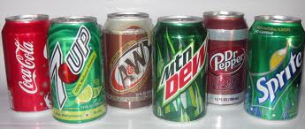
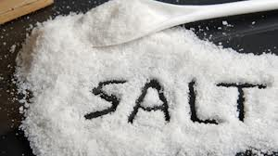
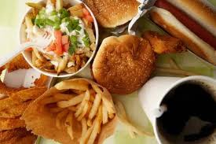
Risk factors
Too much salt – no more than ____
Poor nutrition
Caffeinated beverages

Slide 12
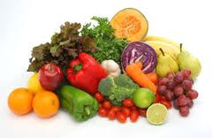
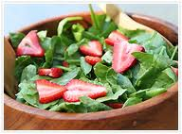
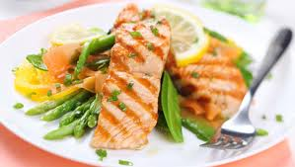
Treatment
DASH diet
dietary approach to stop hypertension
Vegetables
Nuts
Fish
Poultry
Whole grains
Fruits

Slide 13
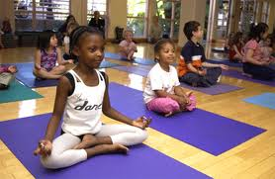
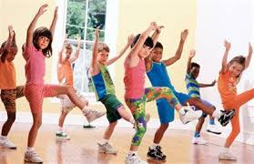
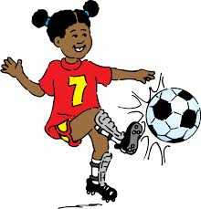
Other treatments
Exercise
Medications
Relaxation techniques
Careful meal planning

Slide 14
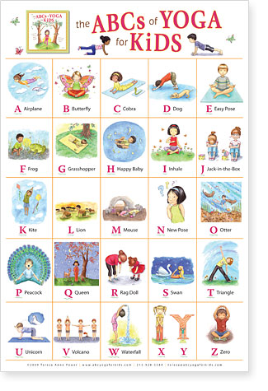

Slide 15
