Slide 1
Hands-Only CPR

Slide 2
Objectives
The student will:
- demonstrate proper procedures of check, call, care
- demonstrate basic CPR techniques on a mannequin
- pass a Red Cross or American Heart Association approved test of CPR skills

Slide 3
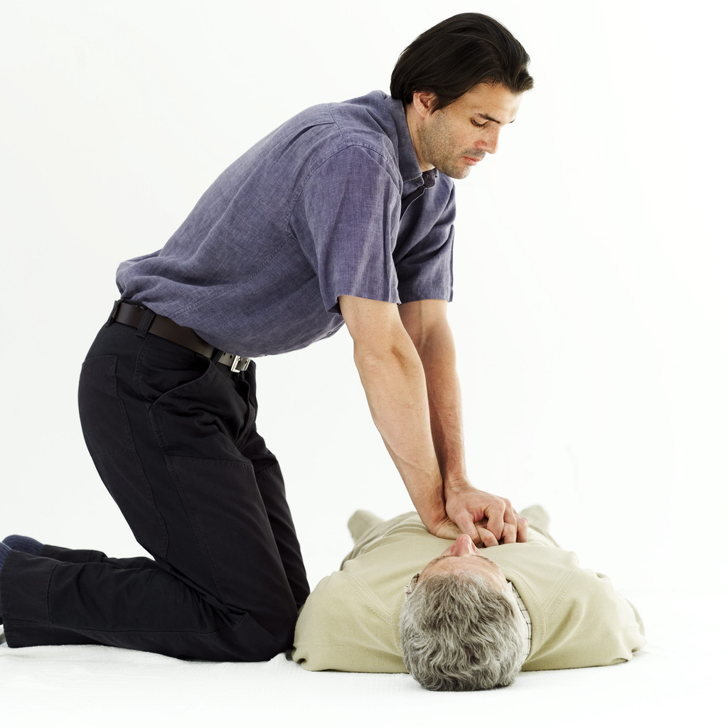
Bellringer
"Should CPR be required for jr high or high school graduation?"

Slide 4
Objectives
I can pass a Red Cross or American Heart Association approved test of CPR skills.
I will demonstrate proper procedures of check, call, care.
I will demonstrate basic CPR techniques on a mannequin.

Slide 5
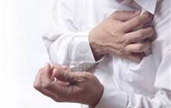
Sudden cardiac arrest is the leading cause of death in adults.

Slide 6
CPR
It is estimated that about 60 percent of heart attacks resulting in cardiac arrest occur in the presence of a witness who might be able to save the victim.
About two-thirds of the deaths caused by cardiac arrest occur before victims can reach a hospital.
CPR doubles a person’s chance of survival from sudden cardiac arrest.

Slide 7
CPR
CPR provides oxygenated blood to the brain and heart and keeps these organs alive until defibrillation shocks the heart back to a normal rhythm.

Slide 8
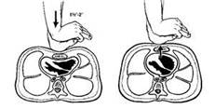

Slide 9
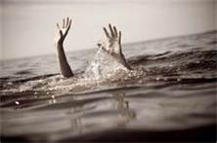
Recognize the signs and symptoms of cardiac events/sudden death emergencies (heart attack, drowning, electrocution, and asphyxiation).

Slide 10
The Three Cs of emergencies:

Slide 11
1. Check out the situation.
Secure the scene
allvoices.com

Slide 12
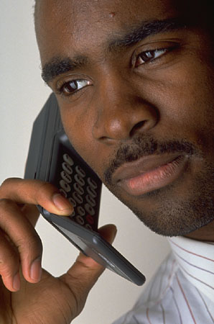
2. Call for help.
- locate nearest phone.
- provide EMS with current address.
- Provide number for EMS to contact

Slide 13
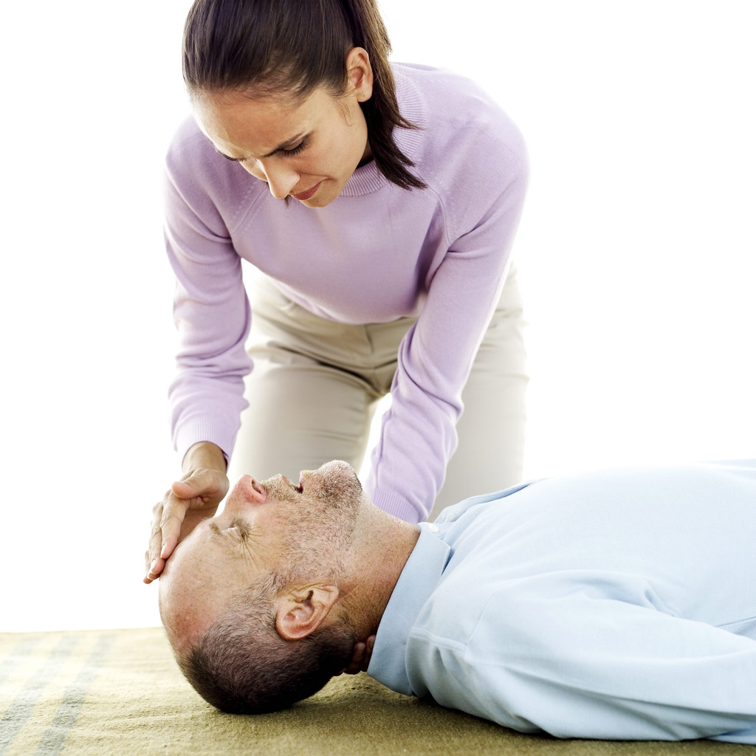
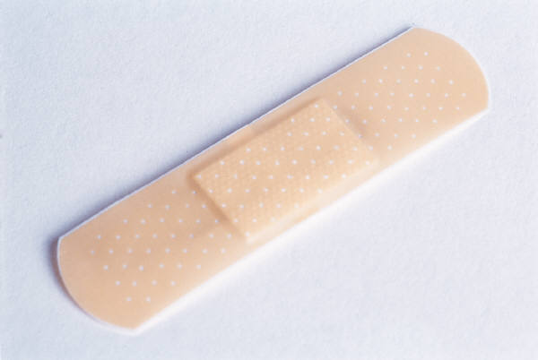
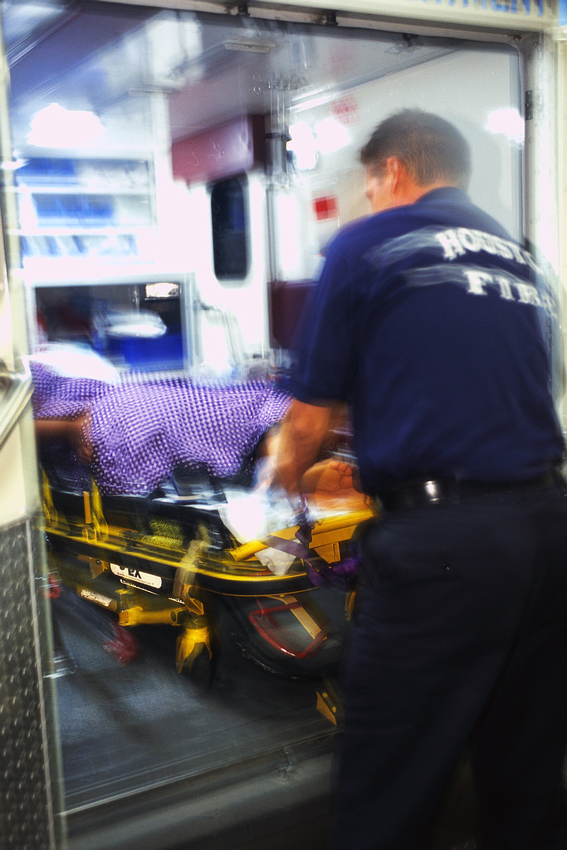
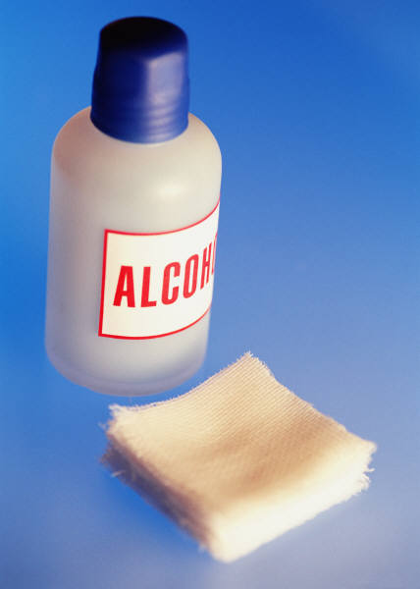
3. Care for the victim.

Slide 15
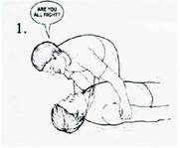
Check the scene for safety.
Tap and shout to check responsiveness of the victim.
Are you okay?

Slide 16
If the victim is unresponsive, immediately send someone or call for help (911) and then begin CPR.

Slide 17
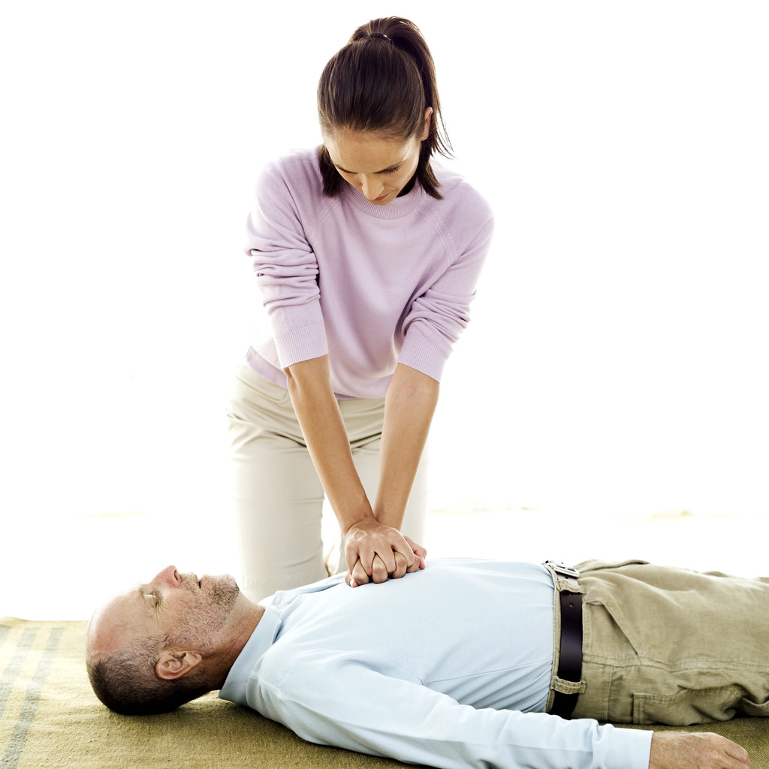
Position victim for compressions.

Slide 18
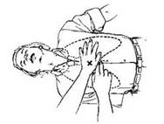
Place the heel of one hand on the center of the breastbone, between the nipples.
Place your free hand on top and lock fingers.

Slide 19
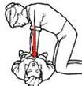
Compress the chest with your upper body weight keeping the heel of your hand centered on the breastbone.
Keep elbows locked.

Slide 20
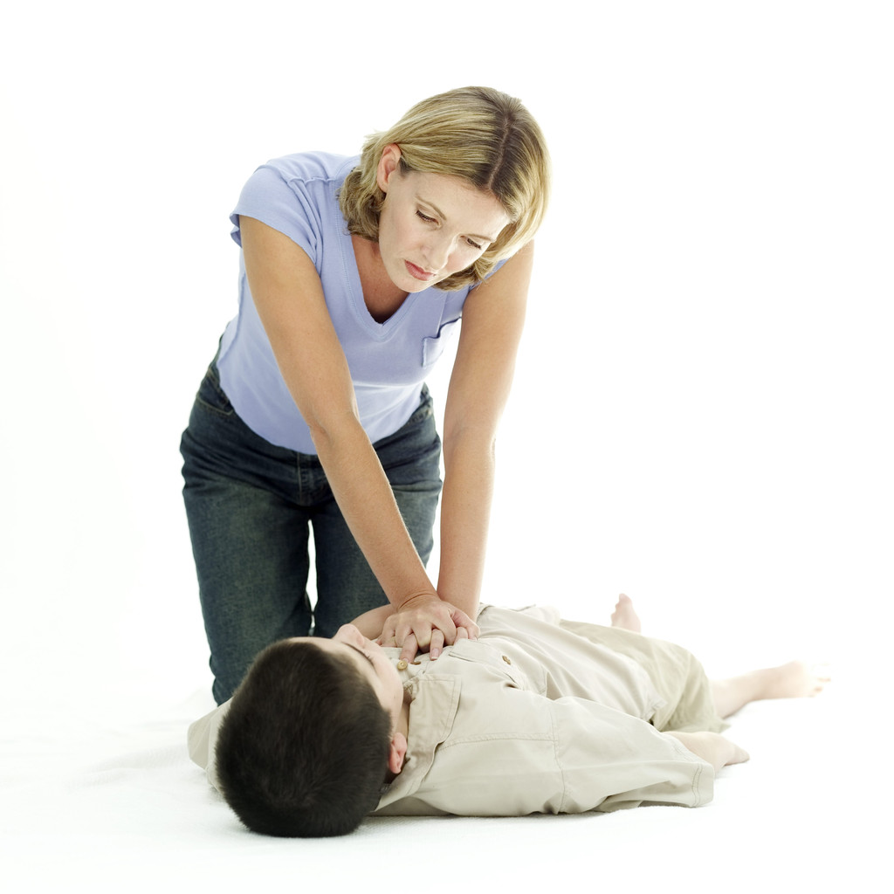
Step 3
Give chest compressions at a rate of 100 per minute. compression depth (2 inches)
speed (100 per minute)

Slide 21
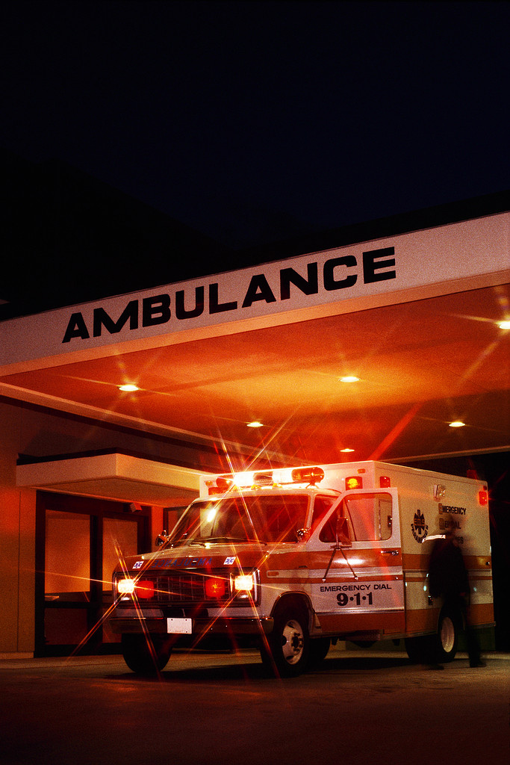
Continue compressions until …..
the victim shows an obvious sign of life
the scene becomes unsafe
an AED becomes available
you are too exhausted to continue
or a trained responder takes over

Slide 22
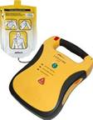
AED KNOWLEDGE
AUTOMATED
EXTERNAL
DEFIBRILLATOR

Slide 24
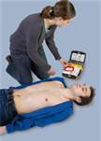
Turn on AED and follow automated instructions.
1. Adjust victim’s clothing to enable pad-to- skin contact.

Slide 25
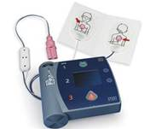
Open pad package and plug in pad connector.

Slide 26
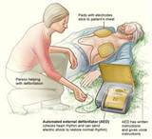
3. Peel pad backing and apply both pads.

Slide 27
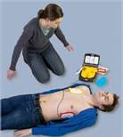
4. Wait and stand clear as AED performs analysis.

Slide 28
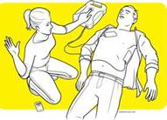
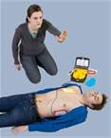
5. If instructed, press shock button.

