Slide 1
Do Now:
Where can you find a food label?
What information can be found on a food label?
How many servings of fruits, vegetables, carbohydrates, and proteins should you have per day?
How many glasses of water should you consume per day?

Slide 2
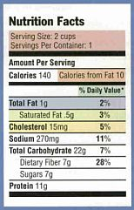
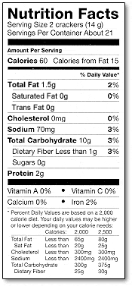
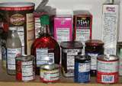
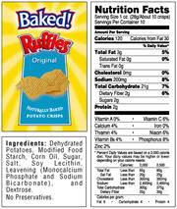
Nutrition and Food Labeling
Samuel Merritt University
Janice, Karen, Kristine, and Laura

Slide 3
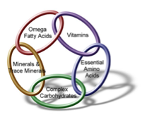
Classes of Nutrients
Carbohydrates
Fats
Proteins
Vitamins
Minerals
Water
Notes:
Carbs: preferred energy source for brain and important for cells. Include sugars, starches, and fiber
Fat: lipids. Energy giving nutrient. 2nd form of energy storage
Protein: class of amino acids. Needed to build, repair, and regulate body
Vitamins: for health and growth
Minerals: needed for bone formation and enzyme activity

Slide 4
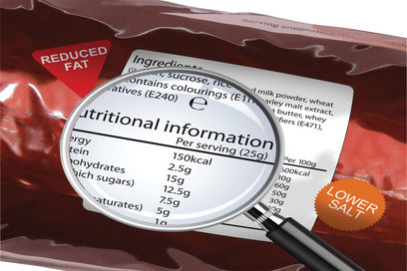
What’s on the Label?
Serving size/ # of servings
Calories per serving
Calories from fat
% Daily Value
Total fat
Types of fat
Cholesterol
Sodium (salt)
Total carbs
Fiber
Protein

Slide 5
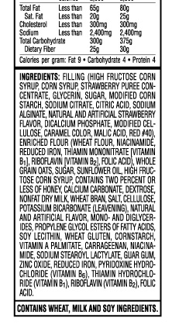
Ingredients
Listed from largest amount to smallest amount

Slide 6
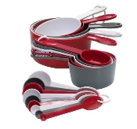
Serving Size
Standard measure of food
How much makes up a single serving
Servings per container
Expressed in kitchen terms
Cups, tablespoons, ounces, grams, slices, etc…
All data on label is based on serving size

Slide 7
How many servings?
Carbohydrates: Recommended 158-228 grams/day (45-65% of daily intake)
Proteins: Recommended 35-105 grams/day (10-30% of daily intake)
Fats: Recommended 31-46 grams/day (20-30% of daily intake)
Fiber: Recommended a minimum of15 grams per day
Sodium (salt): Recommended intake to be < 2400 mg/day
Teaspoon of table salt
Water: 7-8 cups per day

Slide 8
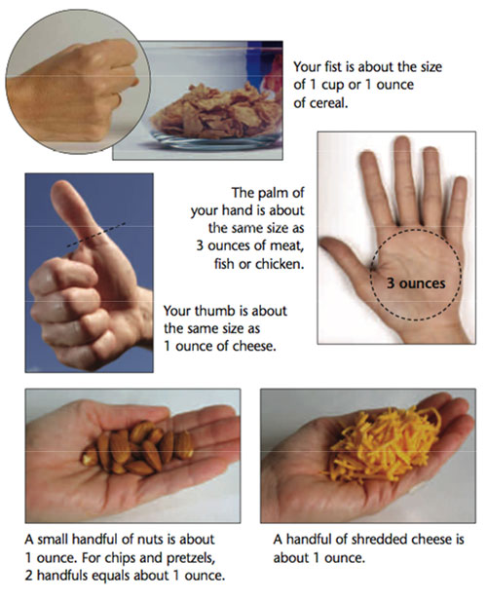
More on Serving Size
Amount per serving- number of calories in a single serving

Slide 9
What does it look like?

Slide 10
Look at your label….
How many servings is in this package?
What is considered ones serving?
How many calories is in ONE serving?
How many calories are in the ENTIRE package?
How many grams of total fat in ONE serving?
How many calories of fat are in ONE serving?
How many grams of carbohydrates are in the ENTIRE package?

