Slide 1
Diabetes

Slide 2
Warm Up Questions
How many people do you know have diabetes?
What is diabetes?
Diabetes can be dangerous if it’s not treated. What happens if diabetes isn’t controlled? What problems can this cause?
Can diabetes be prevented?

Slide 3
How glucose gets into your body
You eat.
Glucose from the food gets into your bloodstream.
Your pancreas produces a hormone called insulin.
Your body gets the energy it needs.
Insulin transports glucose into the body’s cells.

Slide 4
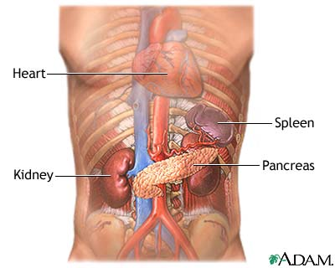
The Pancreas
A long, flat gland in your abdomen that helps your body digests food
It also makes Insulin
Insulin helps transport glucose into the cells of the body

Slide 5
What is Diabetes?
Diabetes is a disease that affects how the body uses glucose
Glucose is a sugar that is the body’s main source of fuel
There are two different types of Diabetes

Slide 6
Type 1 and 2 Diabetes
The glucose can not get into the cells like it normally does, so blood sugar levels get too high.
Excess sugar in the blood can make people very sick if they do not get treatment for it.

Slide 7
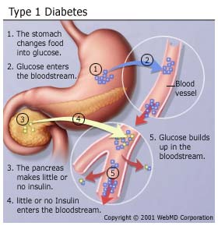
Type 1 Diabetes
The pancreas can not make insulin, so the glucose can not get into your cells
Autoimmune disease
The body destroys cells in the pancreas that makes insulin

Slide 8
Type 2 Diabetes
The insulin in your body does not work like it should
Body makes insulin but most cells do not use insulin properly
Insulin resistance
Slowly, the pancreas stops making insulin.

Slide 9
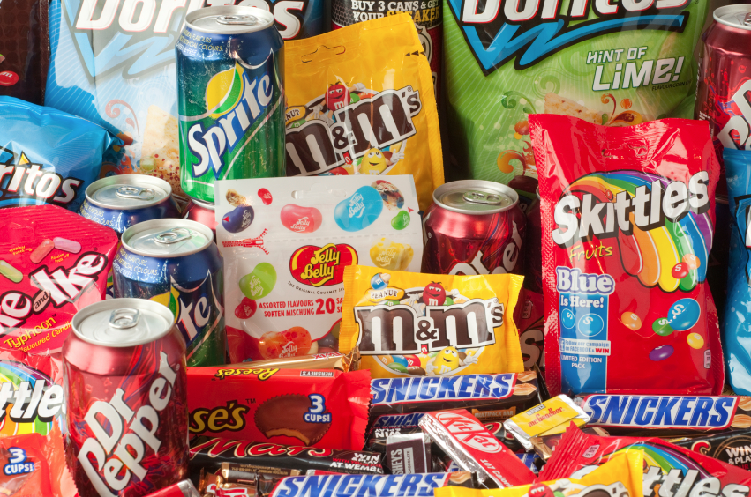
Type 2 Diabetes Risk Factors
Being overweight
Not exercising regularly
Family History
Eating too much fat and sugar

Slide 10
Type 2 Diabetes Prevention
Try to eat foods that are low in fat
Limit fast foods and sugary sodas
Staying active

Slide 11
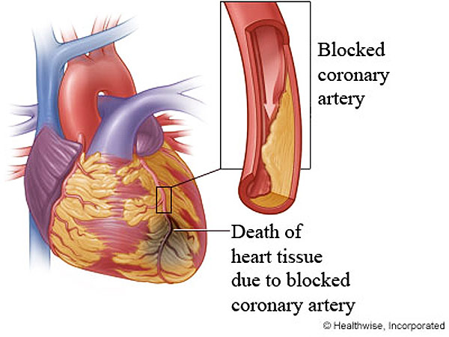
Complications of Diabetes
Heart Disease

Slide 12
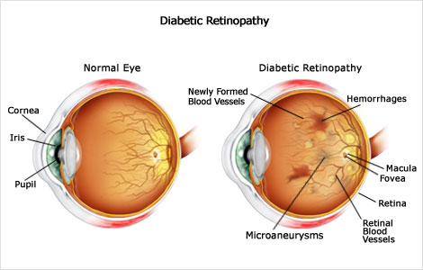
Complications of Diabetes
Blindness

Slide 13
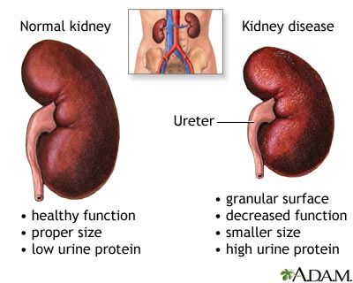
Complications of Diabetes
Kidney Damage

Slide 14
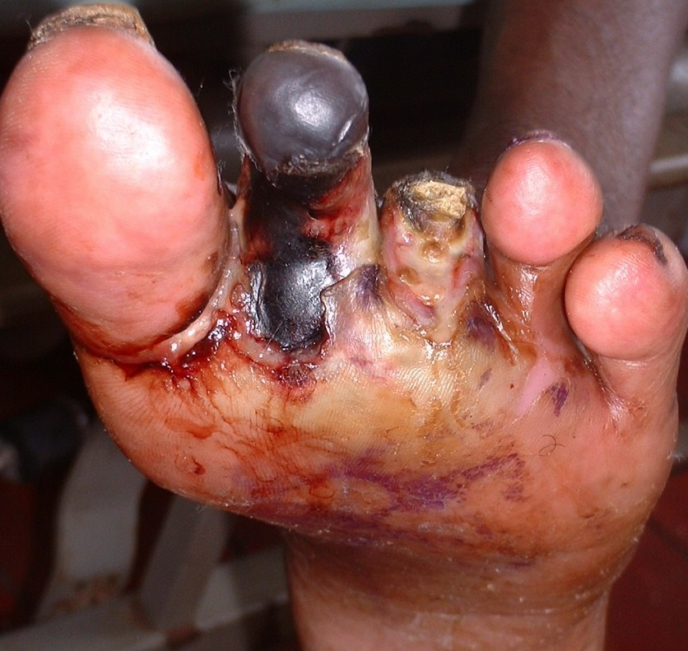
Complications of Diabetes
Nerve Damage

