Slide 1
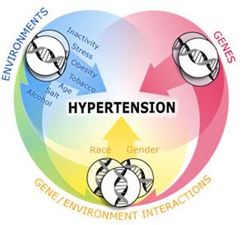
Diet and Hypertension

Slide 2
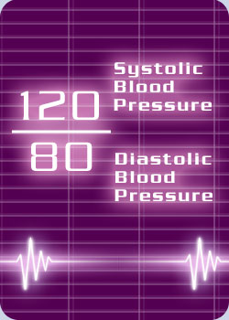
What is Blood Pressure?
The force of blood against the wall of the arteries.
Systolic- as the heart beats
Diastolic - as the heart relaxes
Written as systolic over diastolic.

Slide 3
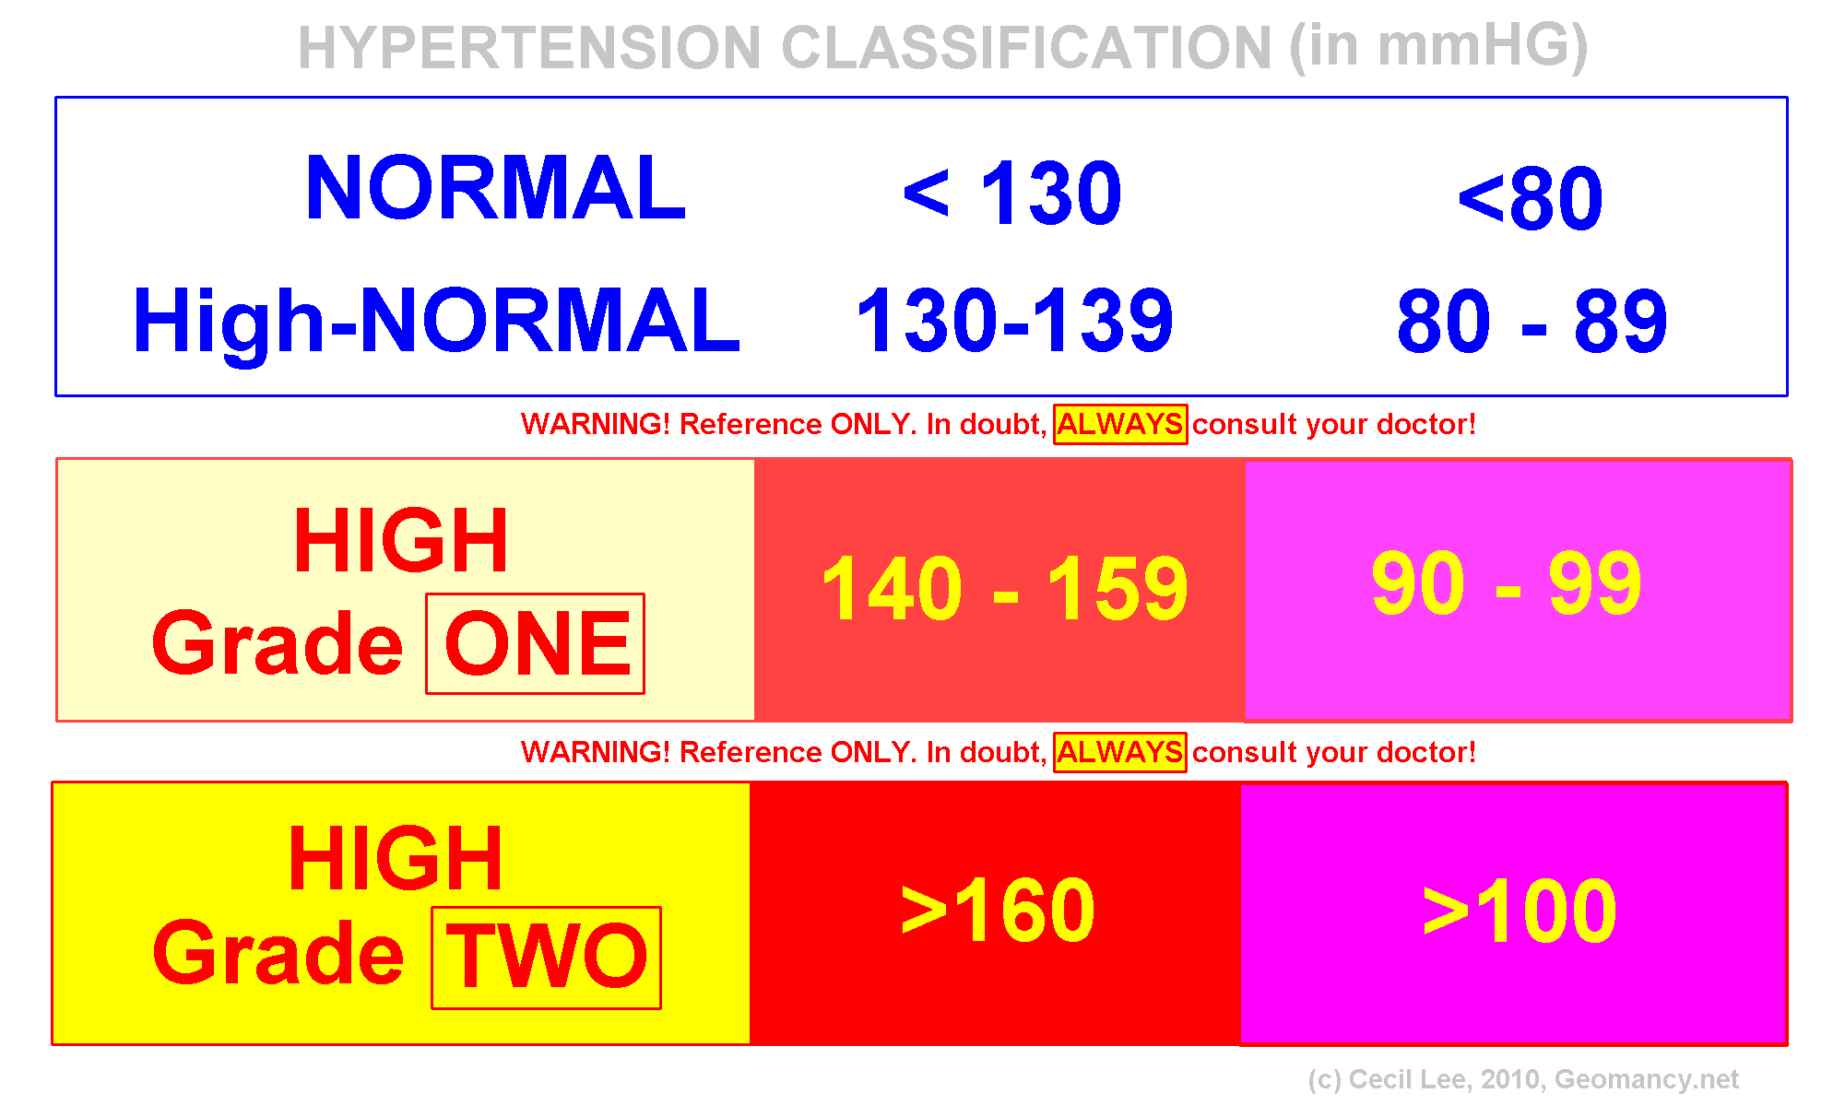
Blood Pressure Classification

Slide 4
High Blood Pressure
A consistent blood pressure of 140/90 mm Hg or higher is considered high blood pressure.
It increases the risk for heart disease, kidney disease, and stroke.
1 out of 4 Americans have High BP.
Has no warning signs or symptoms.
Notes:
High blood pressure increases your chance for getting heart disease and kidney disease or for having a stroke. It is especially dangerous because it has no warning signs or symptoms. It is estimated that one in every four Americans has high blood pressure. Once it develops it can last a lifetime.

Slide 5
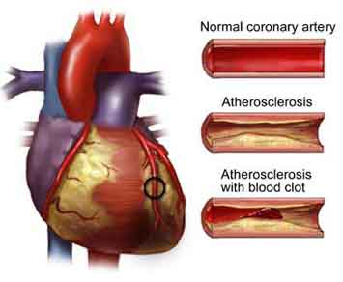
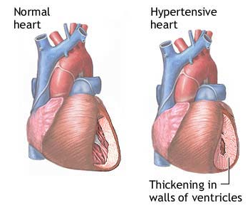
Why is High Blood Pressure Important?
Makes the Heart work too hard.
Makes the walls of arteries hard.
Increases risk for heart disease and stroke.
Can cause heart failure, kidney disease, and blindness.

Slide 6
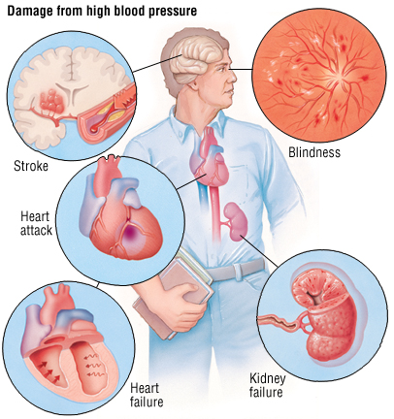
How Does High BP Effect the Body?
Notes:
How does it effect the body?

Slide 7
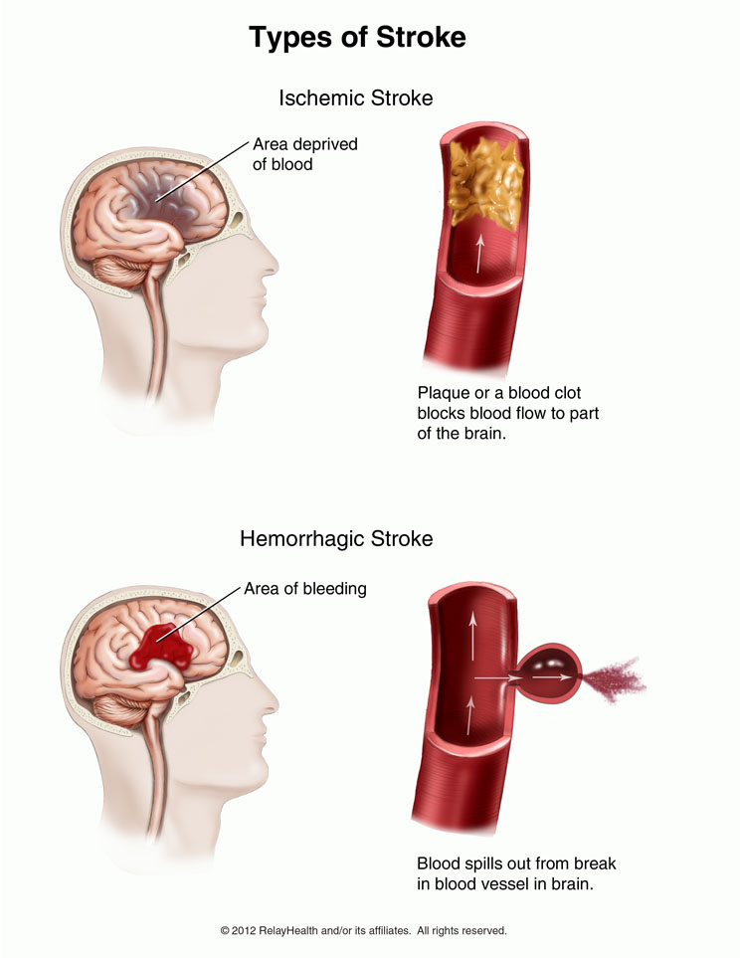
The Brain
High blood pressure is the most important risk factor for stroke.
Can cause a break in a weakened blood vessel which then bleeds in the brain.
Notes:
High blood pressure is the most important risk factor for stroke. This can happen with a break in a weakened blood vessel which bleeds in the brain. A stroke can also happen when a blood clot blocks one of the narrowed arteries in the brain.

Slide 8
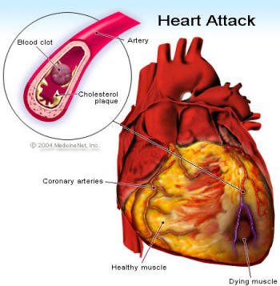
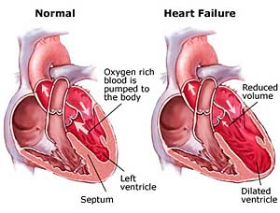
The Heart
High Blood Pressure is a major risk factor for heart attack.
Is the number one risk factor for Congestive Heart Failure.
Notes:
High blood pressure is a major risk for heart attack. The arteries bring oxygen carrying blood to the heart muscle. If the heart cannot get oxygen, chest pain known as angina can occur. If the flow of blood is blocked a heart attack results. Hypertension is also the number one risk factor for congestive heart failure, a condition in which the heart cannot pump enough blood to meet the body’s needs.

Slide 9
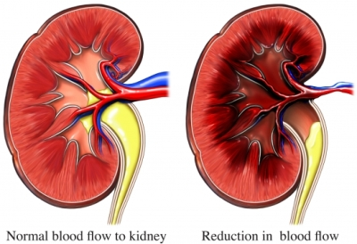
The Kidneys
Kidneys act as filters to rid the body of wastes.
High blood pressure can narrow and thicken the blood vessels.
Waste builds up in the blood, can result in kidney damage.
Notes:
Kidneys act as filters to rid the body of waste. High blood pressure can narrow and thicken the blood vessels. This makes it hard on the kidneys which will filter less blood. This results in waste build up in the blood and may result in the kidneys failure.

Slide 10
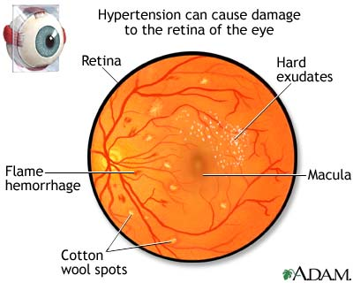
The Eyes
Can eventually cause blood vessels to break and bleed in the eye.
Can result in blurred vision or even blindness.
Notes:
When BP is high for a long period of time, the small blood vessels in the eye undergo a number of changes. The vessels narrow and become constricted in places. Tiny amount of fluid leak from the blood vessels in the retina (the inside layer at the back of the eye). This is called hypertensive retinopathy. Hypertensive retinopathy often has no visual symptoms until it is quite severe. During an eye examination, the eyes are dilated to look for several findings on your retina:
Flame hemorrhages, cotton wool spots (white fluffy areas cause by nerve fiber damage), hard exudates (lipid deposits from damaged blood vessels), swelling of the macula (central portion of the retina responsible for the center of your vision), and swelling of your optic nerve.
The only treatment for hypertensive retinopathy is to control high blood pressure.

Slide 11
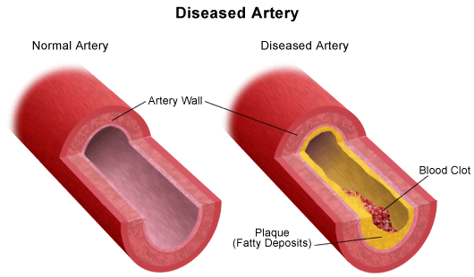
The Arteries
Causes arteries to harden.
This in turn causes the kidneys and heart to work harder.
Contributes to a number of problems.
Notes:
As people get older arteries throughout the body harden especially those in the heart, brain, and kidneys. This in turn causes the kidneys and heart to work harder and can contribute to a number of problems.

Slide 12
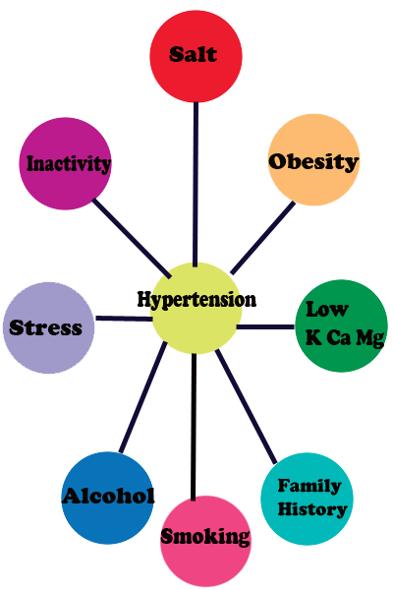
Risk Factors for High Blood Pressure
Age
Race
Family history
Obesity
Inactivity
Tobacco use
Sodium intake
Alcohol intake

Slide 13
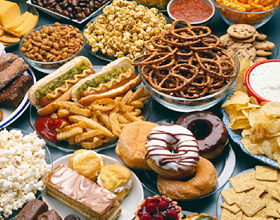
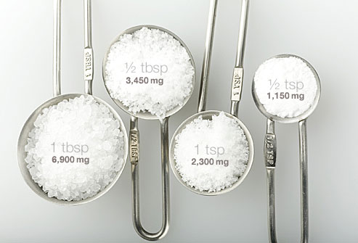
Risk Factors for High Blood Pressure
Poor diet
High cholesterol
Diabetes
Kidney disease
Insufficient sleep
Sleep apnea
Excessive working: > 40hrs/week

Slide 14
High Blood Pressure Detection
Measured using a sphygmomanometer.
2 or more readings of 140/90mm Hg or higher taken on more than one occasion.

Slide 15
Tips for Ensuring Accurate BP Readings
Don’t drink coffee or smoke cigarettes for 30 minutes before.
Before test sit for five minutes with back supported and feet flat on the ground.
Test your arm on a table even with your heart.
Wear short sleeves so your arm is exposed.

Slide 16
Tips for having blood pressure taken.
Go to the bathroom before test. A full bladder can affect BP readings.
Get 2 readings and average the two of them.
Ask the doctor or nurse to tell you the result in numbers and make a note of it.

Slide 17
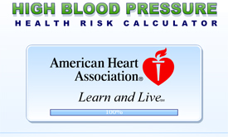
Calculate Your Risk
American Heart Association High Blood Pressure Risk Calculator

Slide 18
Preventing Hypertension
Adopt a healthy lifestyle by:
Following a healthy eating pattern.
Maintaining a healthy weight.
Being Physically Active.
Limiting Alcohol.
Quitting Smoking.
Notes:
The best treatment is prevention.

Slide 19
DASH diet
Dietary Approaches to Stop Hypertension.
Increase of 1 daily serving of veggies.
Increase of 1-2 servings of fruit.
Inclusion of 4-5 servings of nuts, seeds, and beans.

Slide 20
Tips for Reducing Sodium
Buy fresh, plain frozen or canned “no added salt” veggies.
Use fresh poultry, lean meat, and fish.
Use herbs, spices, and salt-free seasonings at the table and while cooking.
Choose convenience foods low in salt.
Rinse canned foods to reduce sodium.
Notes:
The current recommendation is to consume less than 2.4 grams of sodium a day. 2 grams of sodium is equal to 1 teaspoon of salt. Americans consume on average 4000 to 6000 mg of sodium a day. For a person with high blood pressure the doctor my recommend a 1500 mg low sodium diet.

Slide 21
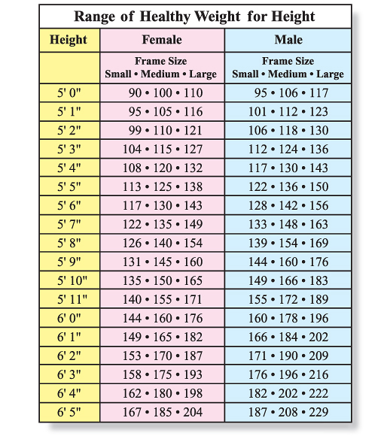
Maintain Healthy Weight
Blood pressure rises as weight rises.
Obesity is also a risk factor for heart disease.
Even a few pounds of weight loss can reduce blood pressure.
Notes:
Being overweight is a risk for developing high blood pressure and other chronic diseases.

Slide 22
Be Physically Active
Weight loss/healthy weight maintenance.
Lowers blood pressure.
30 minutes daily of moderate level activity.
Join a family oriented gym or activity.
Use stairs instead of the elevator.
Park your car further away and walk.
Start a walking club.
Home fitness videos and web-streams.

Slide 23
Limit Alcohol Intake
Alcohol raises blood pressure and can harm liver, brain, and heart.
What counts as a drink?
  12 oz beer
  5 oz of wine
  1.5 oz of 80 proof whiskey
Drink in moderation:
  For men: no more than 2 drinks per day
  For women: no more than one drink per day

Slide 24
Quit Smoking
Injures blood vessel walls
Speeds up process of hardening of the arteries.
Damages lungs
Smoking cessation classes/resources (CDC.gov)
Notes:
Smoking injures blood vessel walls and speeds up the process of hardening of the arteries. The risk of having a heart attack is reduced after one year of cessation.

Slide 25
Conclusion
Hypertension is preventable and reversible.
If left uncontrolled, will lead to chronic disease.
Resources:
  www.nhlbi.nih.gov/
  www.cdc.gov
  www.heart.org/HEARTORG/
  www.usda.gov

